Slide 2
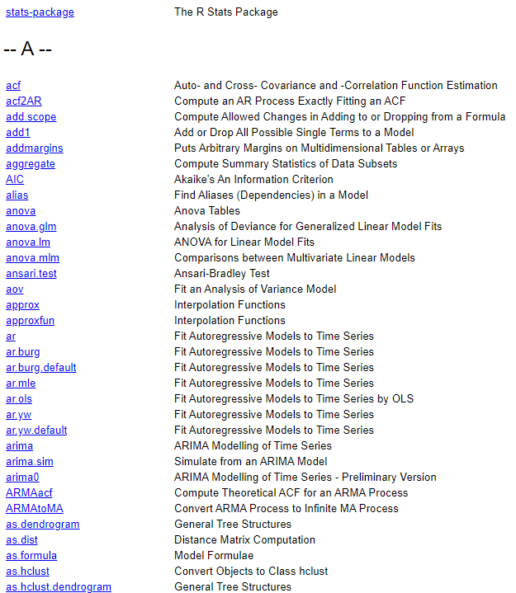
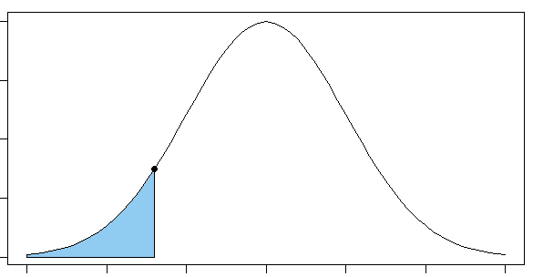
Intermediate/Advanced topics in R - see also: Things you’re now set up to explore yourself if you’d like! -
Statistics!
t.test() one- and two-sample t-tests
chisq.test() chi^2 tests
lm() linear models: simple & multiple regression
glm() generalized linear models: binomial, poisson, …
lme4::lmer() mixed-effects models
All distribution functions!
pnorm()
dnorm()
qnorm()
+ rnorm() …

Slide 3
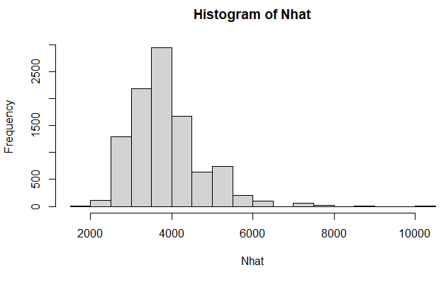
Simulation!
## EXAMPLE: Simulate results from a simple Mark-Recapture experiment…
N <- 4000 # population size
n1 <- 200 # first sample
n2 <- 350 # second sample
# randomly simulate the number of recaptures, 10000 times
m2 <- rhyper(10000, n1, N-n2, n2) # this produces a vector
# Chapman abundance estimate for each simulated replicate...
Nhat <- (n1 + 1)*(n2 + 1)/(m2 + 1) – 1
hist(Nhat) # plot a histogram
quantile(Nhat, p=c(0.1, 0.9)) # 80% interval
10% 90%
2938.625 5038.357

Slide 4
Writing your own functions!
## EXAMPLE: Chapman estimator
NChapman <- function(n1, n2, m2) {
Nhat <- (n1 + 1)*(n2 + 1)/(m2 + 1) - 1
return(Nhat)
}
NChapman(n1=100, n2=200, m2=20)
[1] 965.7143
Writing your own packages??!
Just standardized bundles of functions, documentation, and maybe data
For yourself (handy because you can create good documentation)
For others (can even release to CRAN!)

Slide 5
Loops, etc: Run a piece of code multiple times…
Load multiple files
Run the same analysis for multiple years of data
Produce a sequence of plots
Run a simulation for multiple sets of conditions
…!

Slide 6
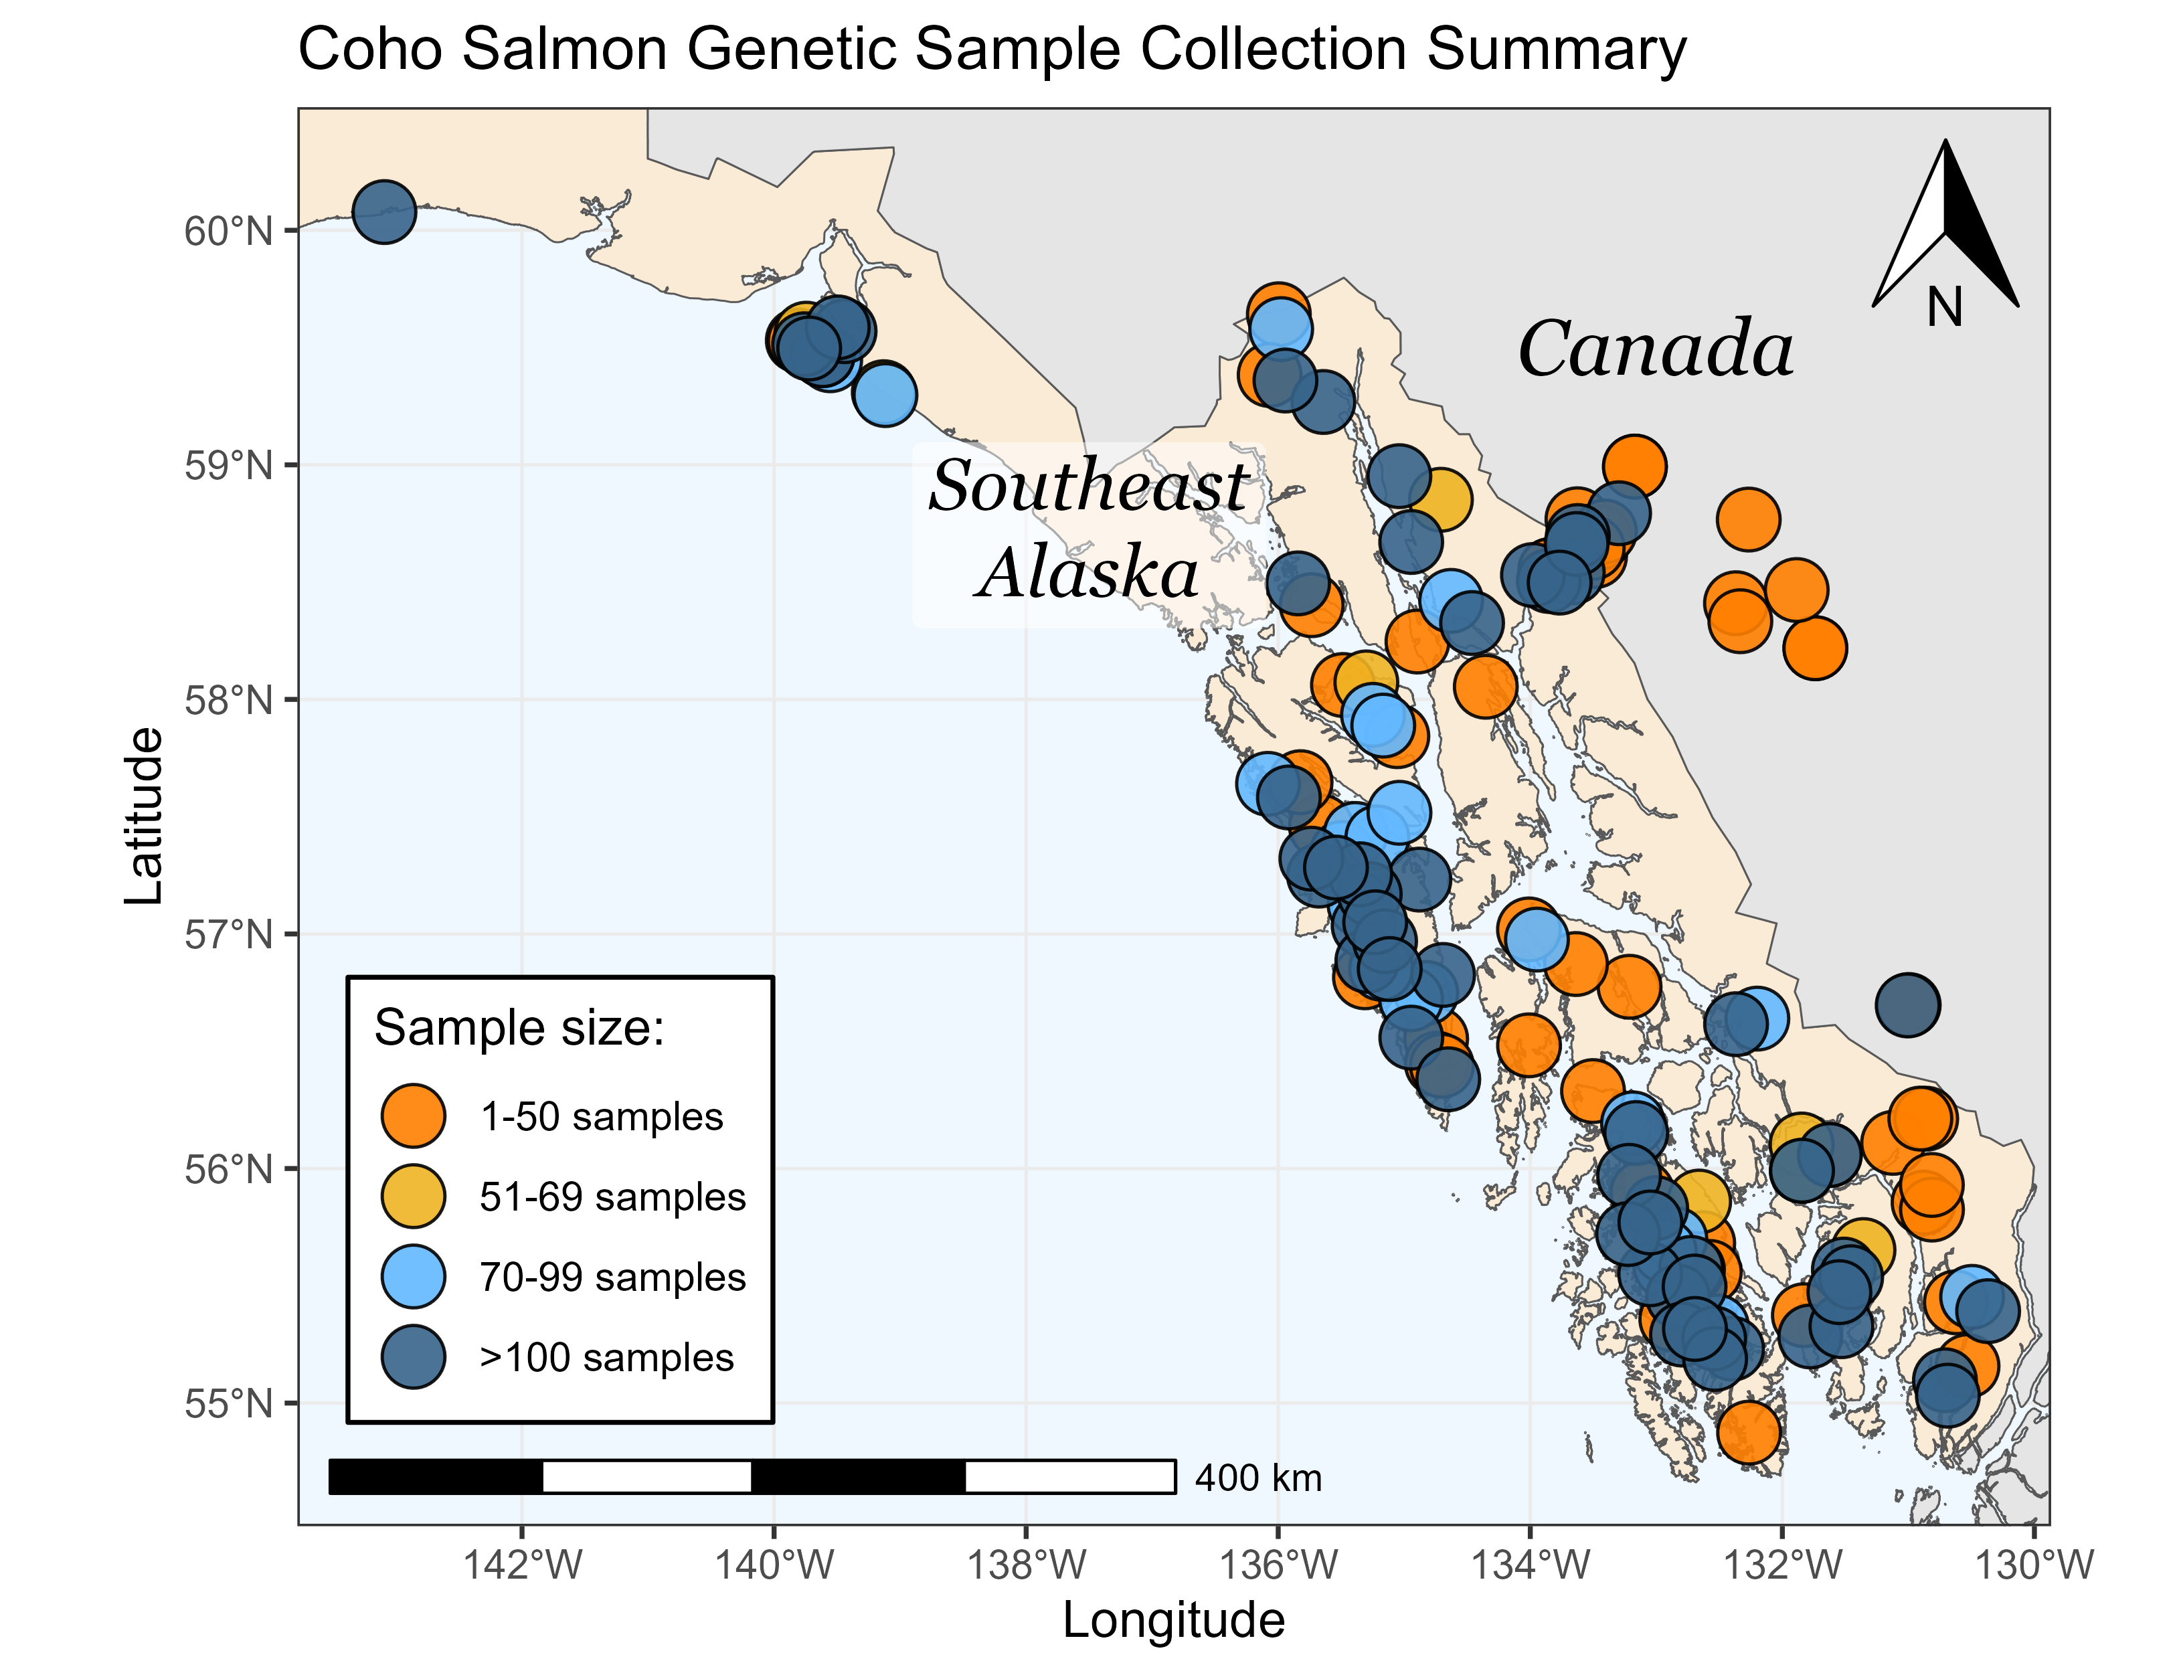
Mapping with sf, leaflet, …
Yes, you can GIS with R!

Slide 7
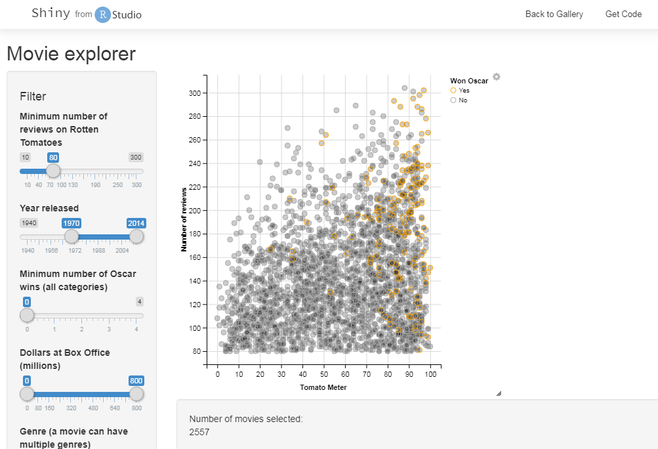
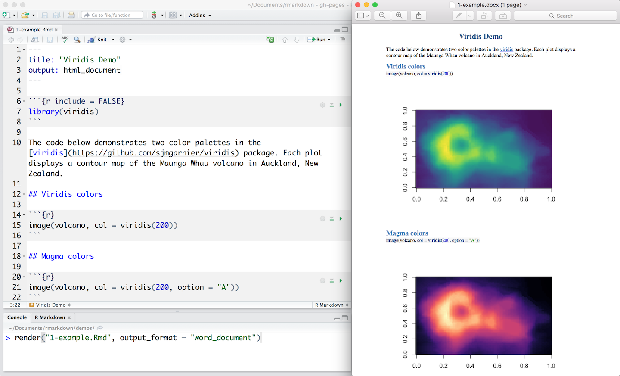
Interactive apps with Shiny:
Write your own GUI interface to run R in the background
Visualization
Twiddling with parameters
Conceptual discussion …
Reproducible documents with Quarto & Markdown
Combines running text and R code, and prints everything to Word, html, or pdf!
No seriously, this is the future.
Seriously.

